Slide 1
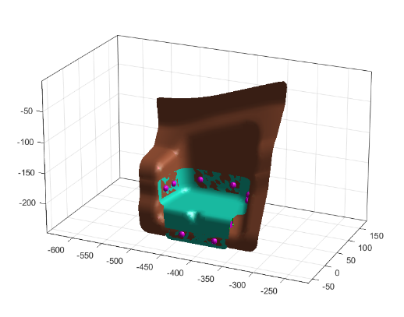
Scaled-UP Process Parameters
Digital Lifecycle Management
5
4
7
3
6
8
1
2
1 to 8

Slide 2
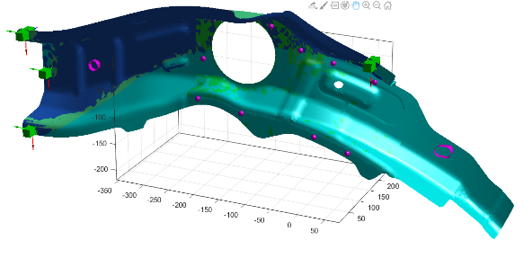
Scaled-UP Process Parameters
Digital Lifecycle Management
17
9
11
12
10
13
18
16
15
14
9 to 18

Slide 3
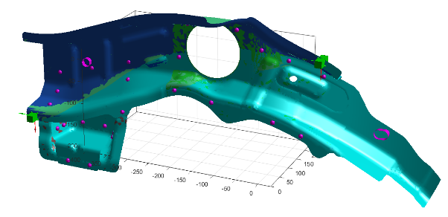
Scaled-UP Process Parameters
Digital Lifecycle Management
21
20
19
23
22
25
24
19 to 25

